Slide 1
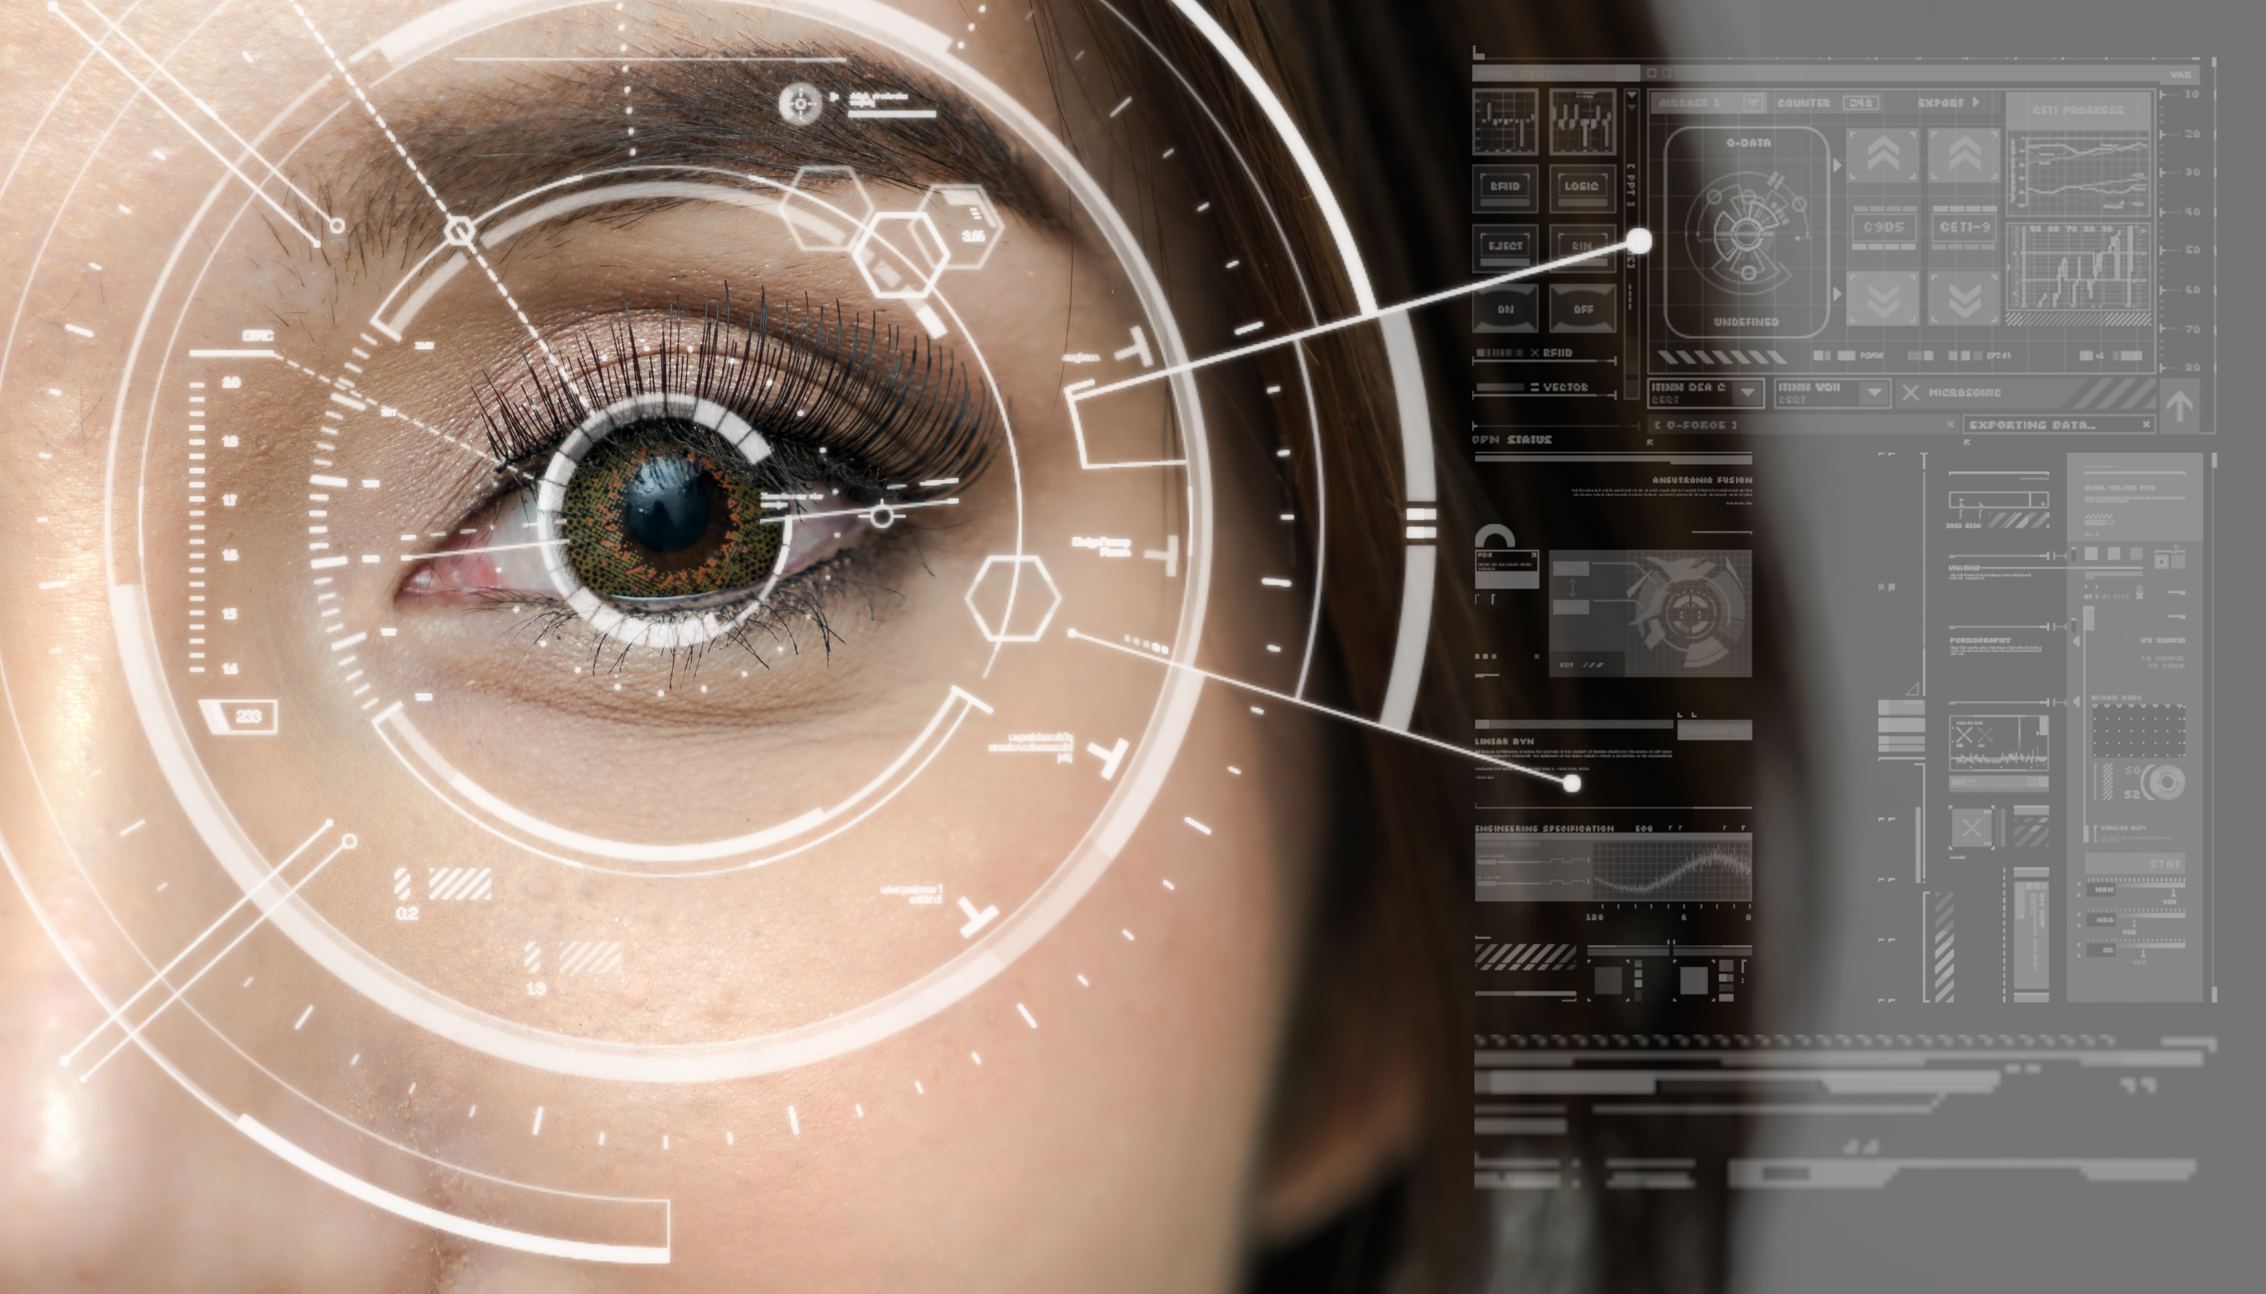

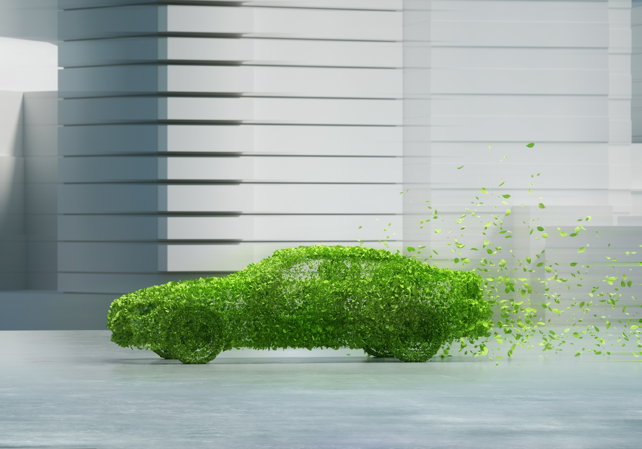



Future is now

Slide 2



01
Another nice
Slide, wowzer
Nice transitions
Make it better

Slide 3
Future is now

Slide 4
01
Another nice
Slide, wowzer
Nice transitions
Make it better

Slide 5

Future is now

Slide 6
01
Another nice
Slide, wowzer
Nice transitions
Make it better

Slide 7
Future is now

Slide 8
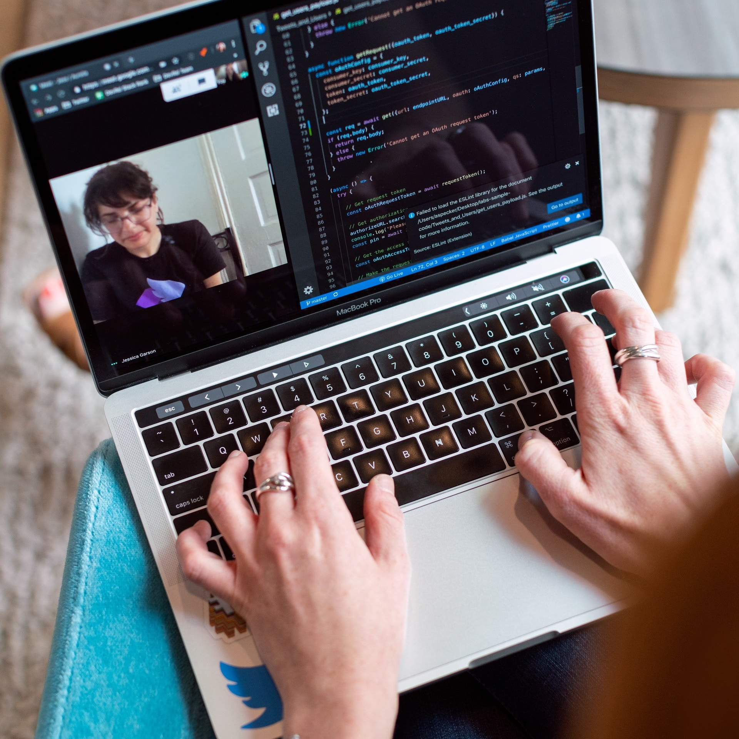

01
Another nice
Slide, wowzer
Nice transitions
Make it better

Slide 9
Future is now

Slide 10
01
Another nice
Slide, wowzer
Nice transitions
Make it better

Slide 11
01
Another nice
Slide, wowzer
Future is now

Slide 12
01
Another nice
Slide, wowzer
Future is now

Slide 13
01
Another nice
Slide, wowzer
Nice transitions
Make it better

